Slide 1



geolocalizacion
View in Power BI
Last data refresh:
11/13/2023 9:55:17 PM UTC
Downloaded at:
11/16/2023 4:36:59 PM UTC

Slide 2
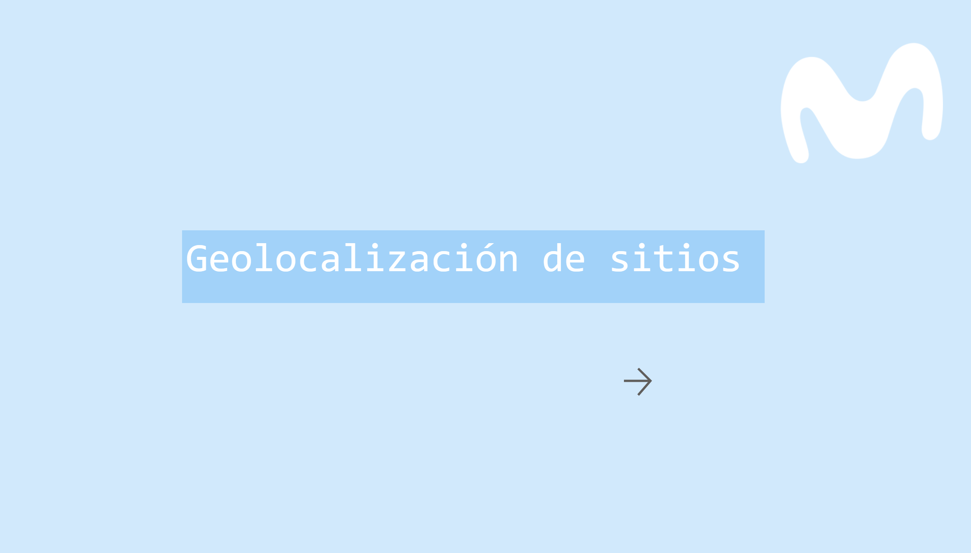
Inicio
Notes:
image
No alt text provided
textbox
No alt text provided
actionButton
No alt text provided

Slide 3
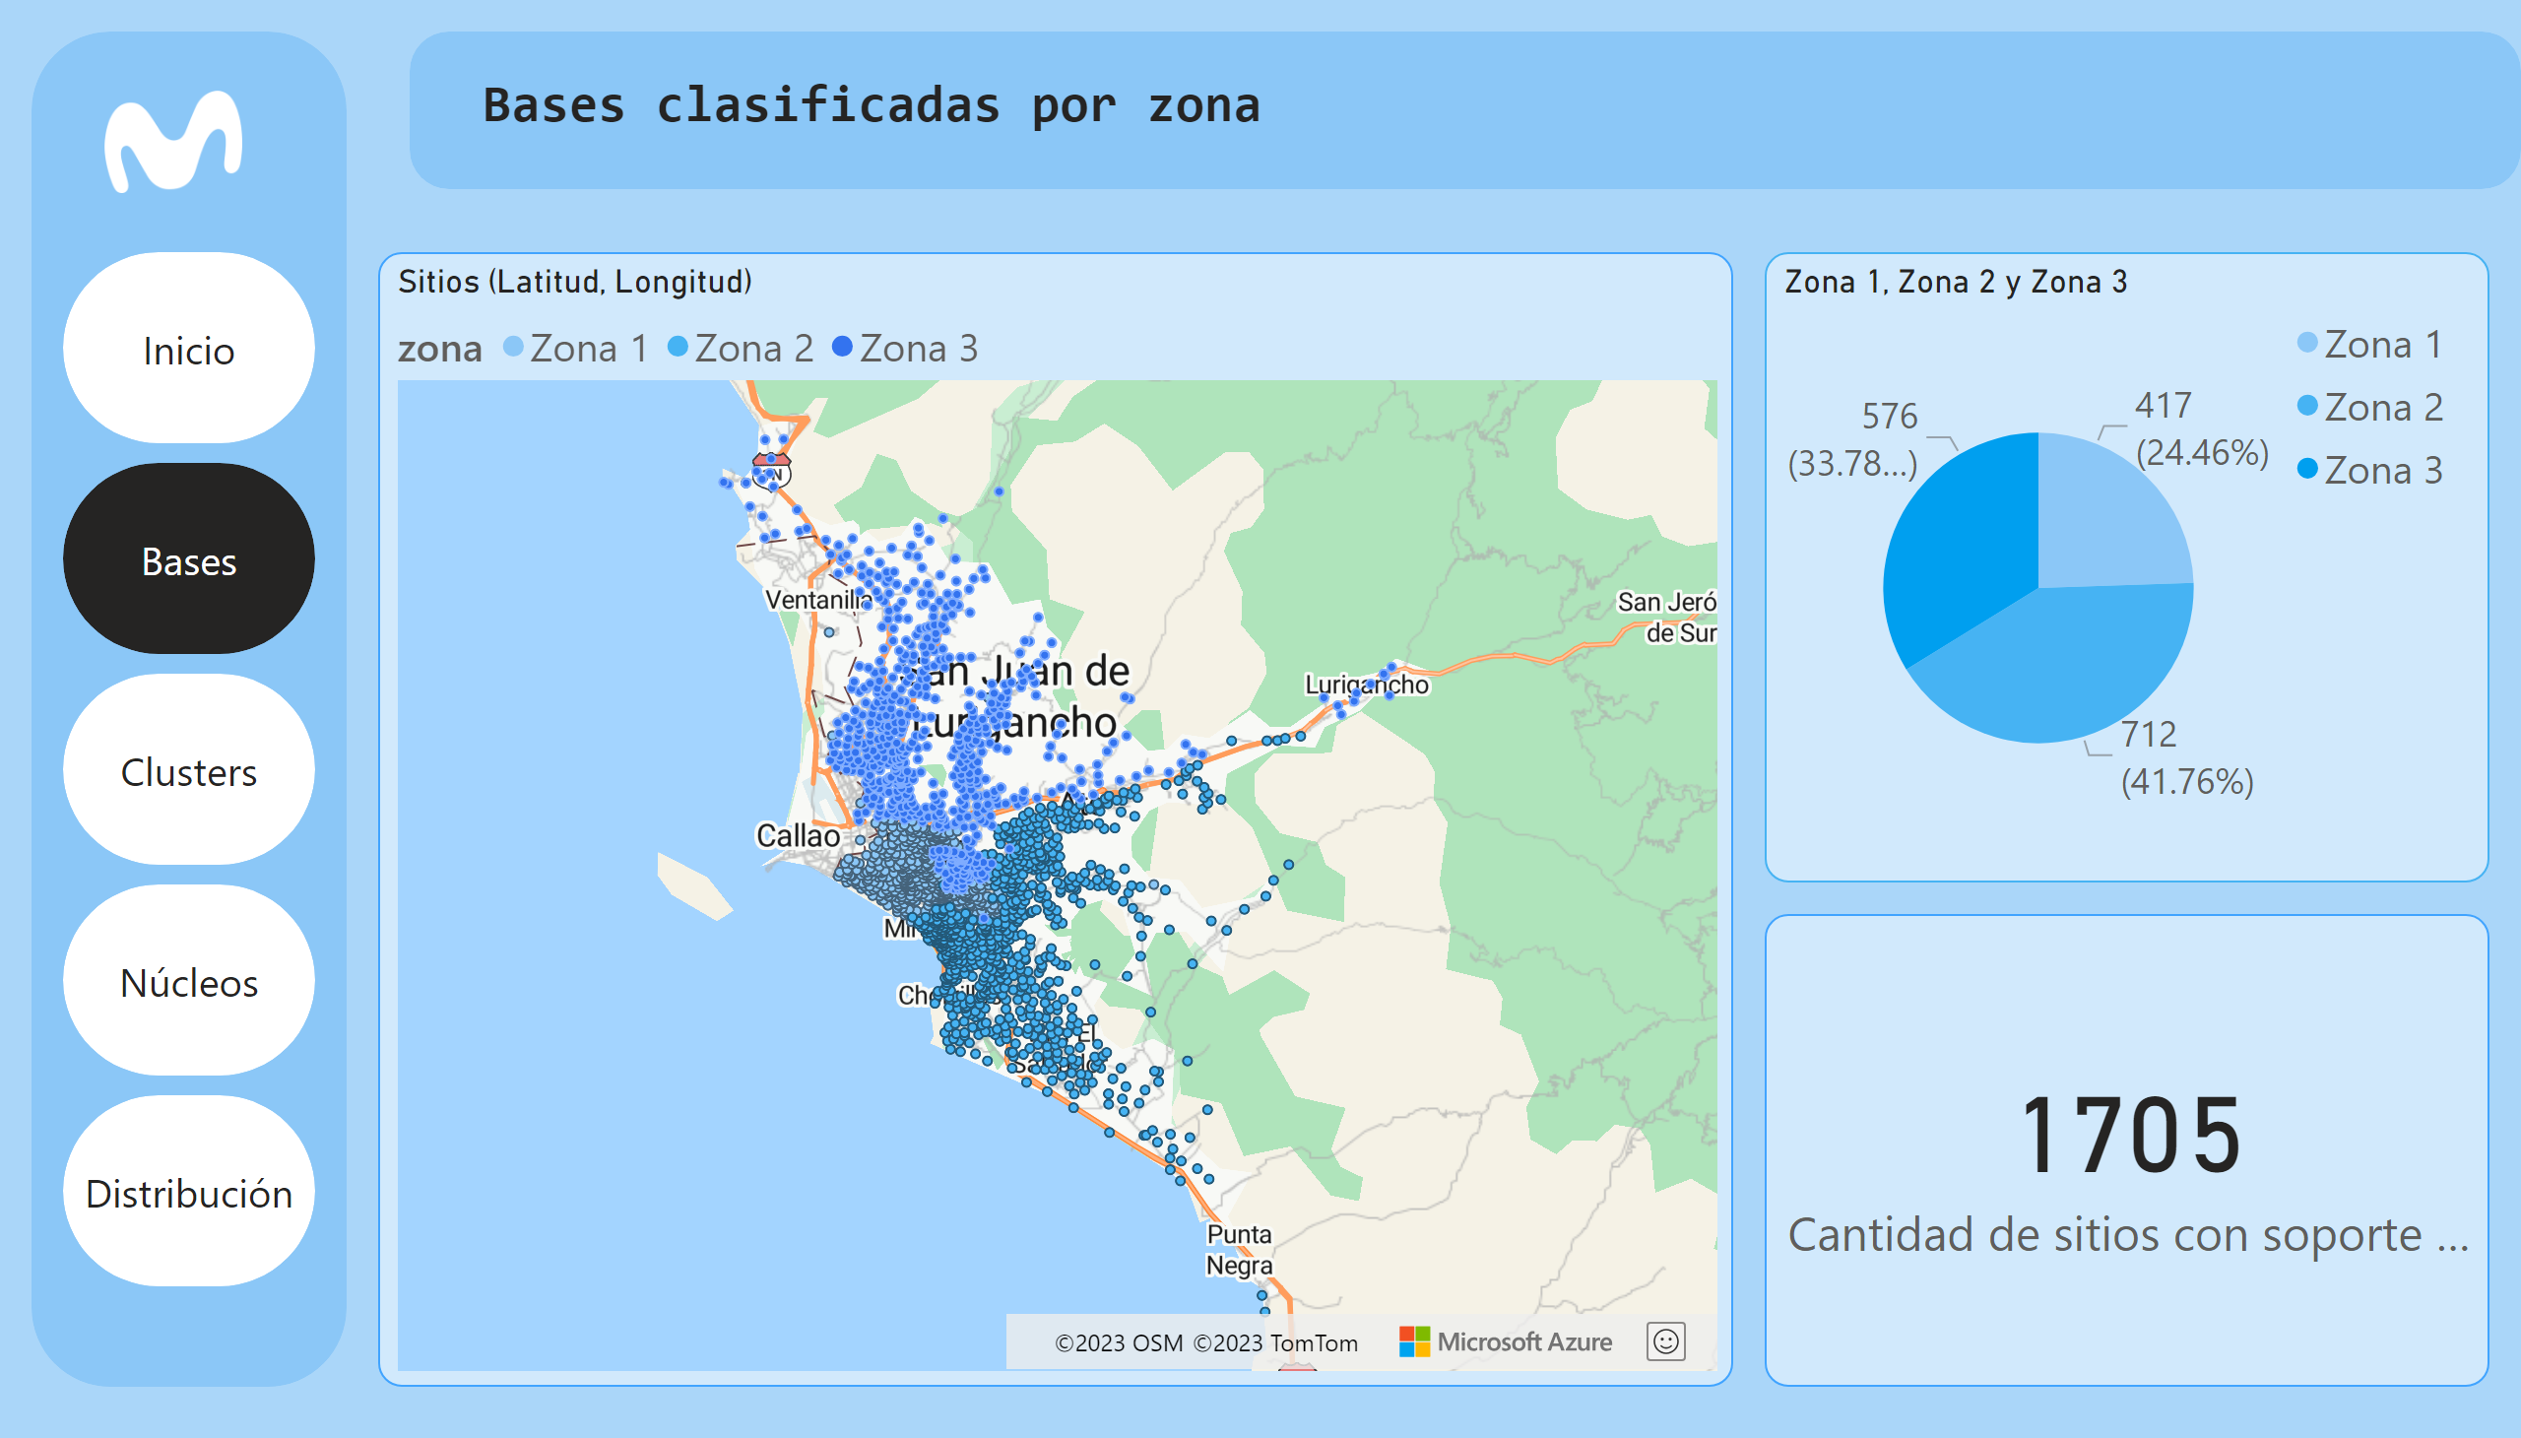
Bases
Notes:
Sitios (Latitud, Longitud)
No alt text provided
textbox
No alt text provided
Zona 1, Zona 2 y Zona 3
No alt text provided
card
No alt text provided
shape
No alt text provided
shape
No alt text provided
image
No alt text provided
pageNavigator
No alt text provided

Slide 4
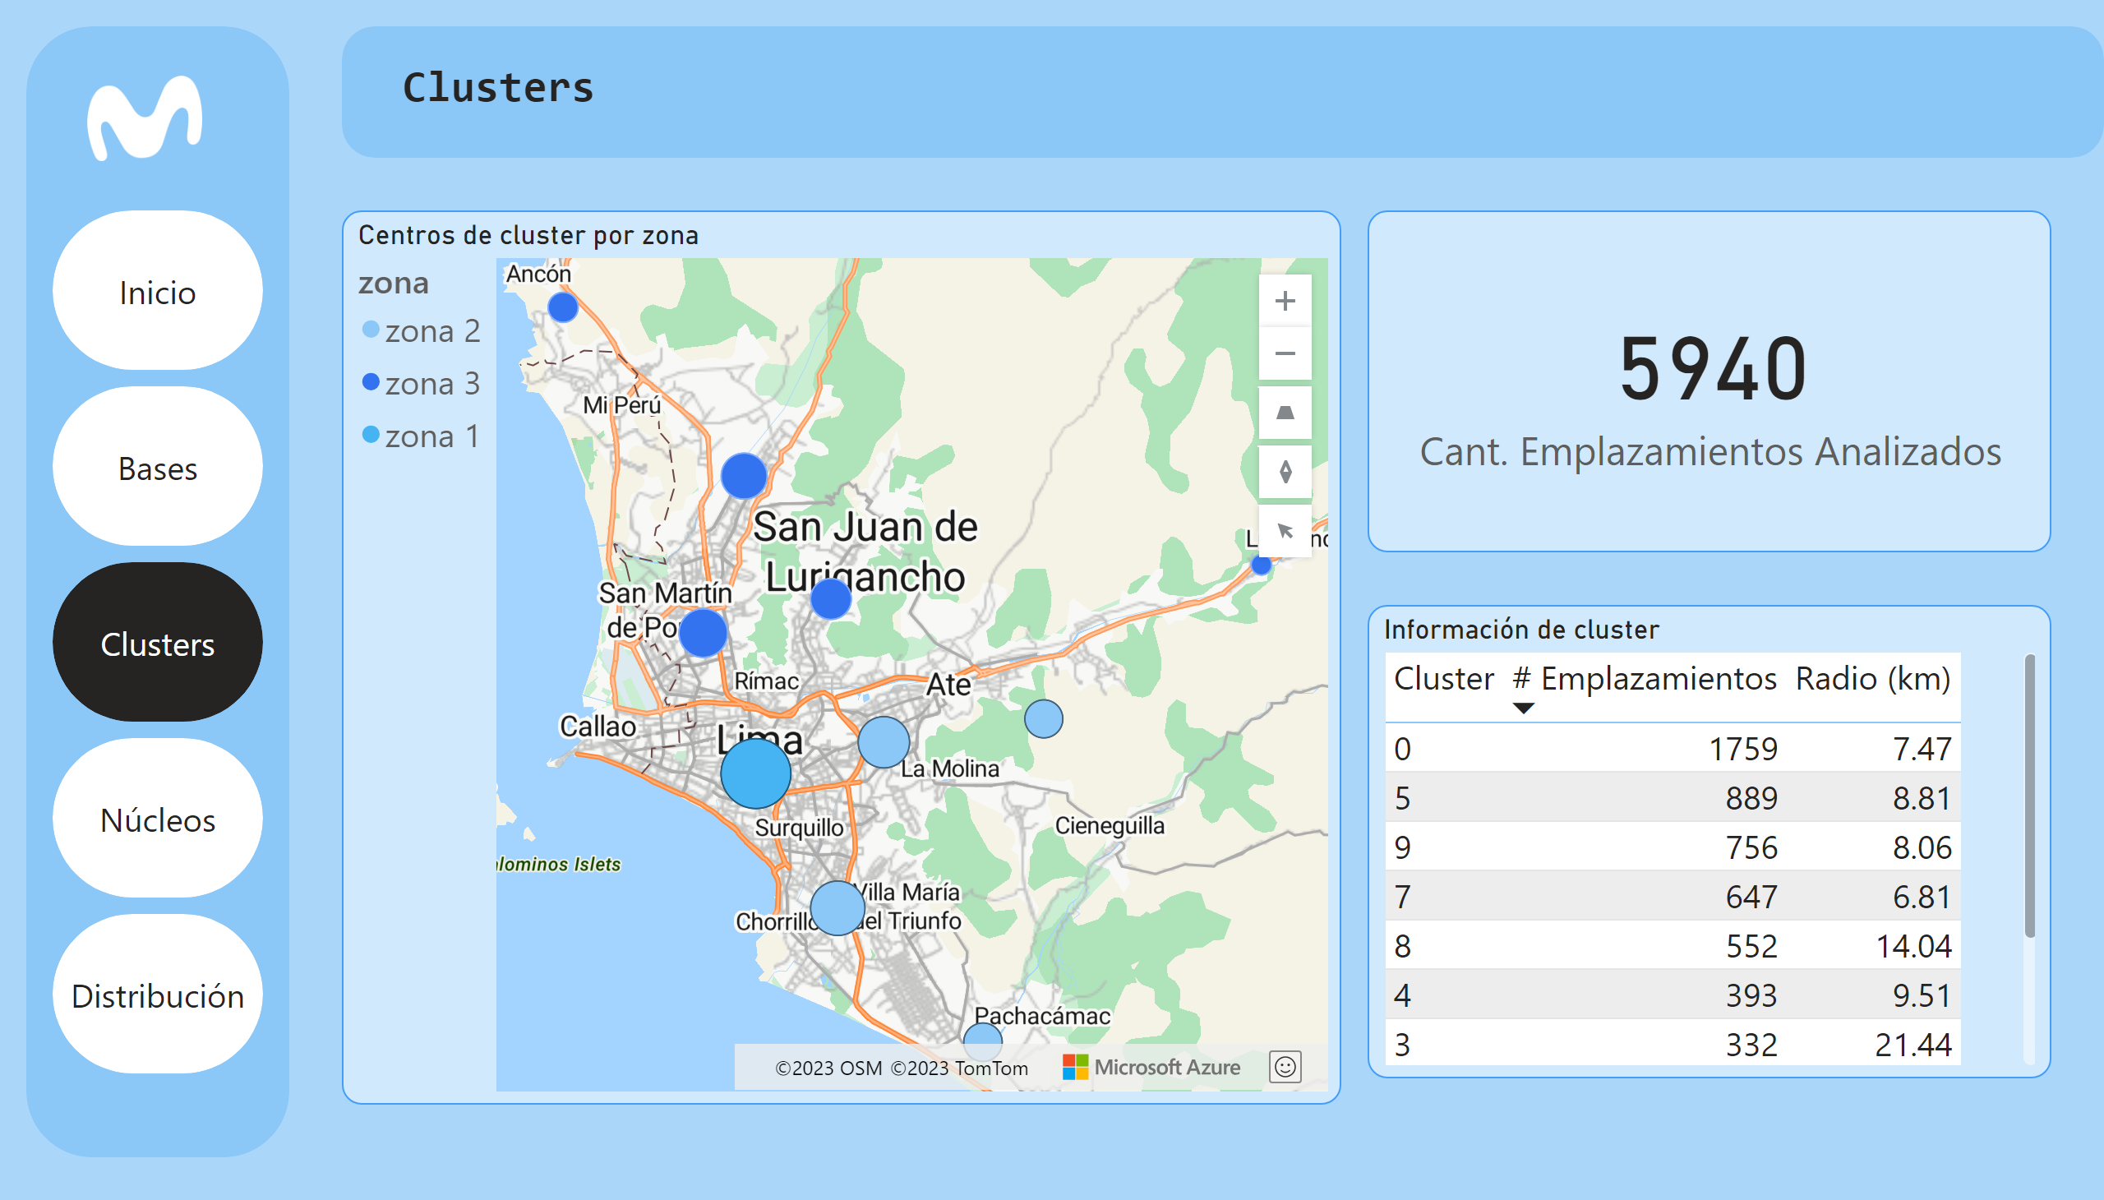
Clusters
Notes:
textbox
No alt text provided
shape
No alt text provided
shape
No alt text provided
image
No alt text provided
Centros de cluster por zona
No alt text provided
Información de cluster
No alt text provided
card
No alt text provided
pageNavigator
No alt text provided

Slide 5
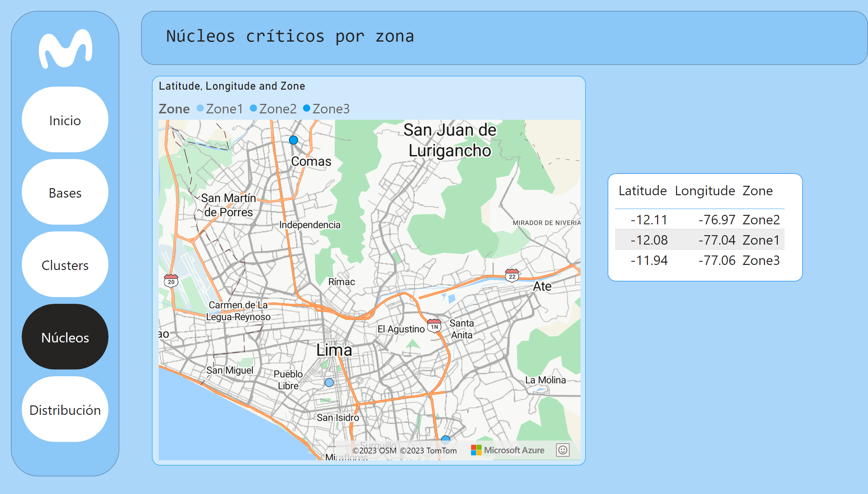
Núcleos
Notes:
textbox
No alt text provided
shape
No alt text provided
shape
No alt text provided
image
No alt text provided
azureMap
No alt text provided
tableEx
No alt text provided
pageNavigator
No alt text provided

Slide 6
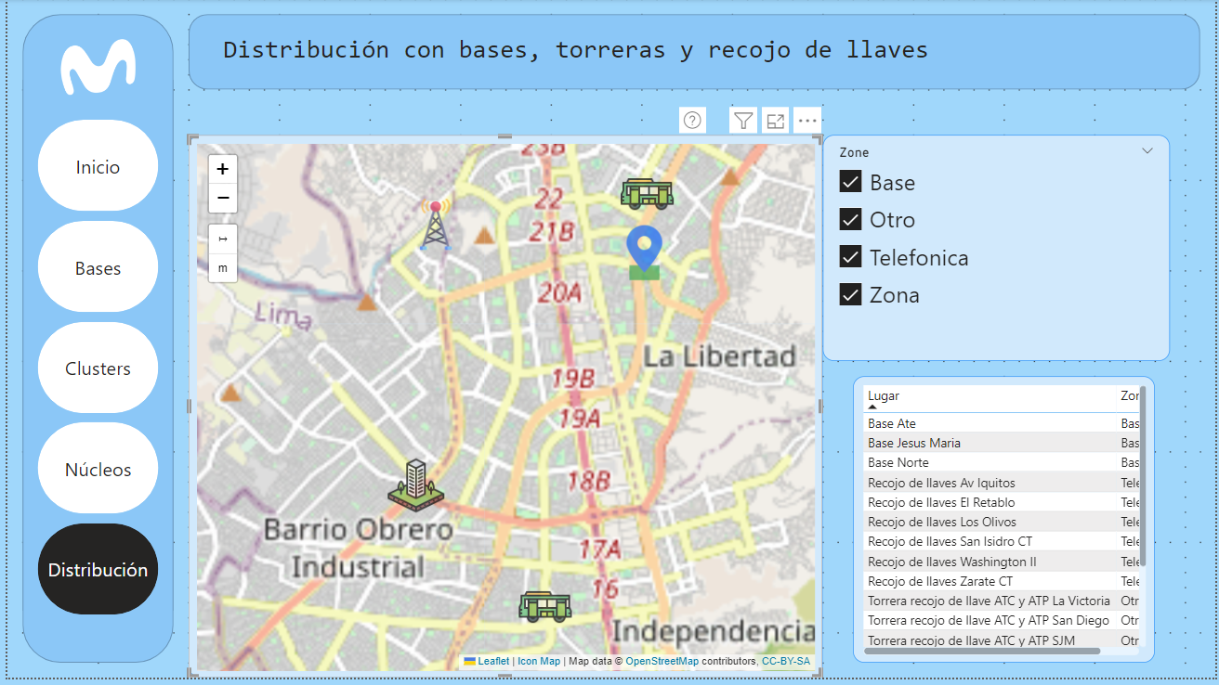
Zona 3
Base Norte

Slide 7
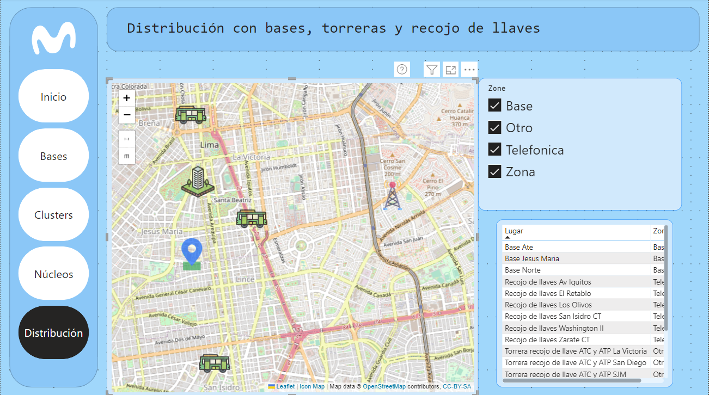
Base Jesús María
Zona 1

Slide 8
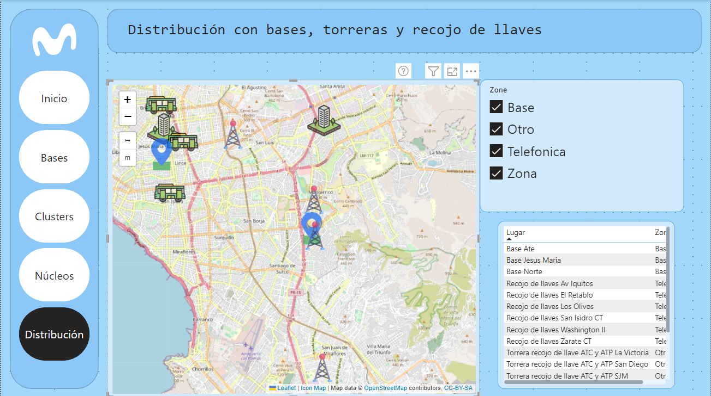
Base Jesús María
Base ate
Zona 2

